Slide 1
Handle Classification Tasks with Large Output Dimension: Word Embedding as Example
Speaker: Kangqi Luo
2016-05-04

Slide 2
Content
Word Embedding as Example
Typical learning model
Problem in time complexity
Hierarchical Softmax
Noise-Contrastive Estimation
Evaluation on Word Embedding Task
Conclusion
Notes:
In this talk, I’ll use word embedding as an example to show you a typical structure of NN model, and how to learn the params in the model.
This model is not perfect because it encounters time complexity problem, so then I will introduce two techniques: HSoft and NCE.
These two techniques could reduce the time complexity in training step and produce the language model in high quality.
Then I’ll show you experimental results in word embedding task and finally conclude my presentation.

Slide 3
Content
Word Embedding as Example
Typical learning model
Problem in time complexity
Hierarchical Softmax
Noise-Contrastive Estimation
Evaluation on Word Embedding Task
Conclusion

Slide 4
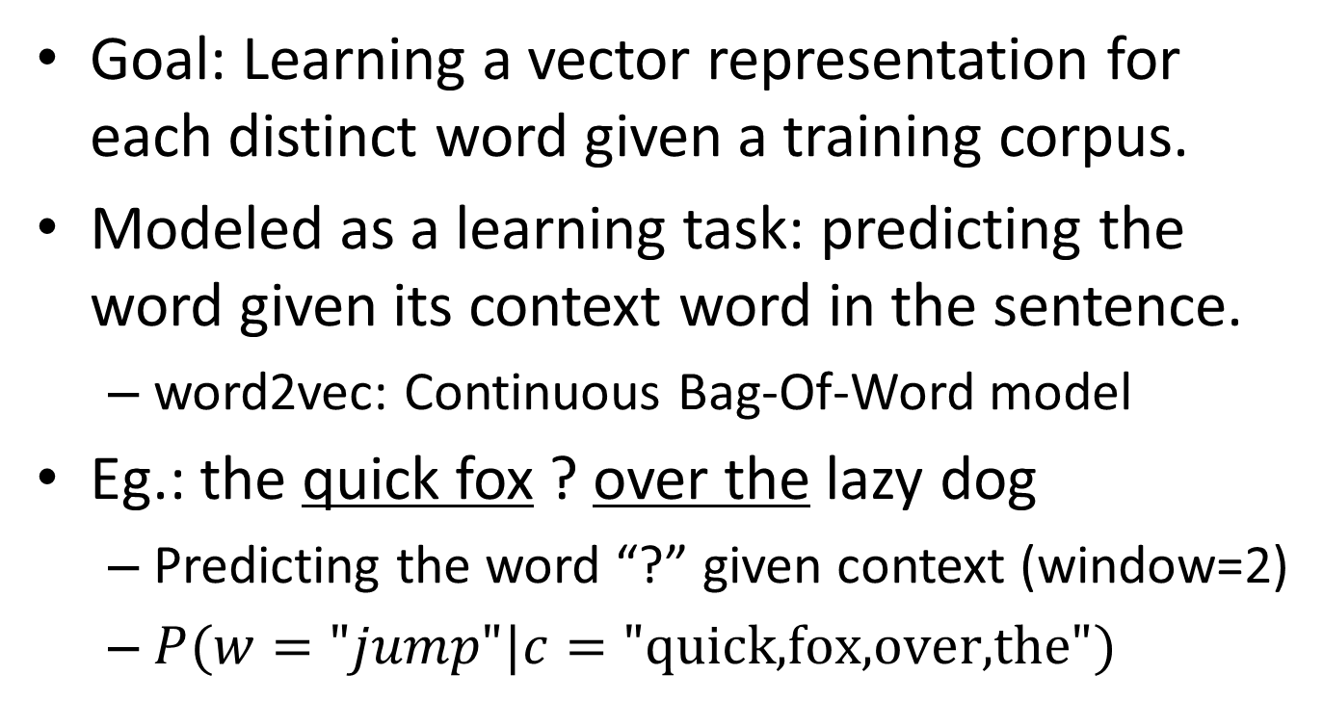
Running Example: Word Embedding
Goal: Learning a vector representation for each distinct word given a training corpus.
Modeled as a learning task: predicting the word given its context word in the sentence.
word2vec: Continuous Bag-Of-Word model
Eg.: the quick fox ? over the lazy dog
Predicting the word “?” given context (window=2)
$P(w="jump"|c=\text{"}\text{quick}\text{,}\text{fox}\text{,}\text{over}\text{,}\text{the}\text{"})$
Notes:
Vector representations are commonly used in machine learning tasks.
in NLP field, we can use a vector to represent one word, where each dimension in the vector indicates a hidden semantics.
Now let’s look at a real scenario the vector representation helps.
If you are familiar with w2v, this task corresponds to CBOW model.
[Example]
Now I’m going to show you how to build the language model by NN.

Slide 5

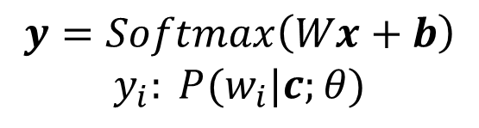

Modeled in Neural Networks
output layer
(V-dim)
Prob. for each word
$$y=Softmax\left(Wx+b\right)$$
$$y_{i}: P(w_{i}|c;θ)$$
projection layer (D-dim)
$$x=\sum_{i}{v_{i}}$$
embedding vector
input layer
(D-dim)
……
$$v_{i}=Tc_{i}$$
(table lookup)
c₁=quick
c₂=fox
c₄=the
word layer
(V-dim)
[0,1,0…,0,0]
[0,0,0…,0,1]
[0,0,0…,1,0]
Notes:
The goal of this NN model is to represent P(w|context) in a complex style, and to learn parameters in this function such that the prob. function best fits training data.
Word layer: context word (on board: 1-out-of-V vector: length V, zeros but only 1)
Input layer: convert word into vector representation through a matrix T (D*V matrix, which is the table storing vector representation of each word)
Projection layer: simple, merge context semantics together.
Output layer: use another matrix W(V*D) and bias vector b(V) to produce probabilistic distribution of the output word. This step is called softmax regression.
So once you combine these functions together, you’ll get a complex function of P(w|c) parameterized by T, W, b.
Parameter: T, W, b
====
During training step, based on loss function, we use gradient descent to adjust parameters, such that J can be minimized

Slide 6
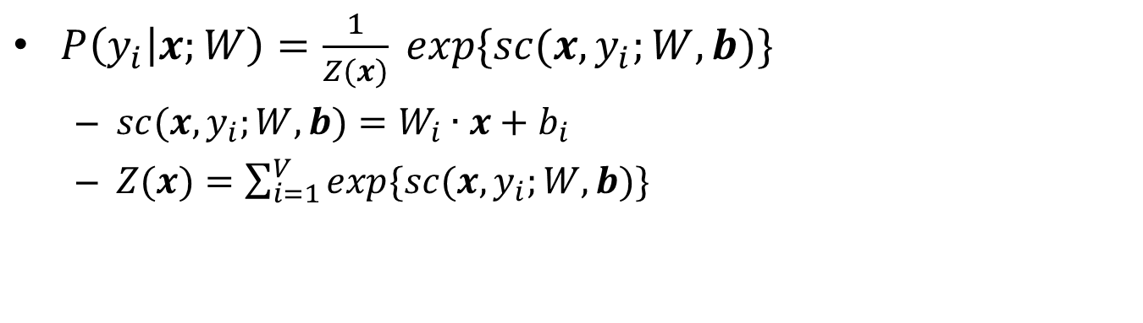


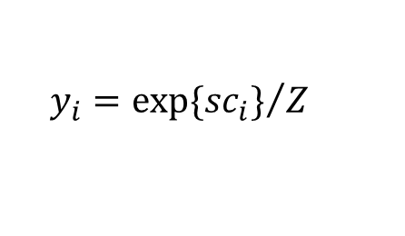

Softmax Regression
$P\left(y_{i} | x;W\right)=\frac{1}{Z(x)} exp\{sc(x,y_{i};W,b)\}$
$sc(x,y_{i};W,b)=W_{i}∙x+b_{i}$
$Z(x)=\sum_{i=1}^{V}{exp⁡\{sc(x,y_{i};W,b)\}}$
x₁
$$W_{1},b_{1}$$
sc₁
y₁
probability
of words
x₂
$$W_{V},b_{V}$$
projection
vectors
sc_{V}
y_{V}
x_{D}
$${{sc}_{i}=W}_{i}∙x+b_{i}$$
$$y_{i}={exp⁡\{{sc}_{i}\}}/Z$$
| Linear | normalization |
Notes:
This figure shows softmax regression in detail.
The input comes from projection layer, then we first calculate the score of each output word w_i with x.
Notice that score is calculated by linear combination.
With score calculated, we normalize the score into a probabilistic distribution. We use exponential function such that probability ranges from 0 to 1.
====
then the we measure the cond. prob. of y_k based on feature vectors and the corresponding parameter theta_k
don’t worry about the formula, the following figure shows how it works.
input fv: feature vectors of some case, output y: cond. prob. for each class
recap the previous example and feature functions, obviously we have fv1 = 1, ……
z_k represents the confidence score of assigning the k-th POS tag for this case, which is a linear comb. between fv and theta.
the step from z to y is just a normalization, turning confidence scores into probs.
In terms of training, we generate a loss function based on conditional probability for each training data, and adjust weight theta by minimizing the loss functions
the final weight shows the association between a semantic clue and a canidate POS tag.

Slide 7
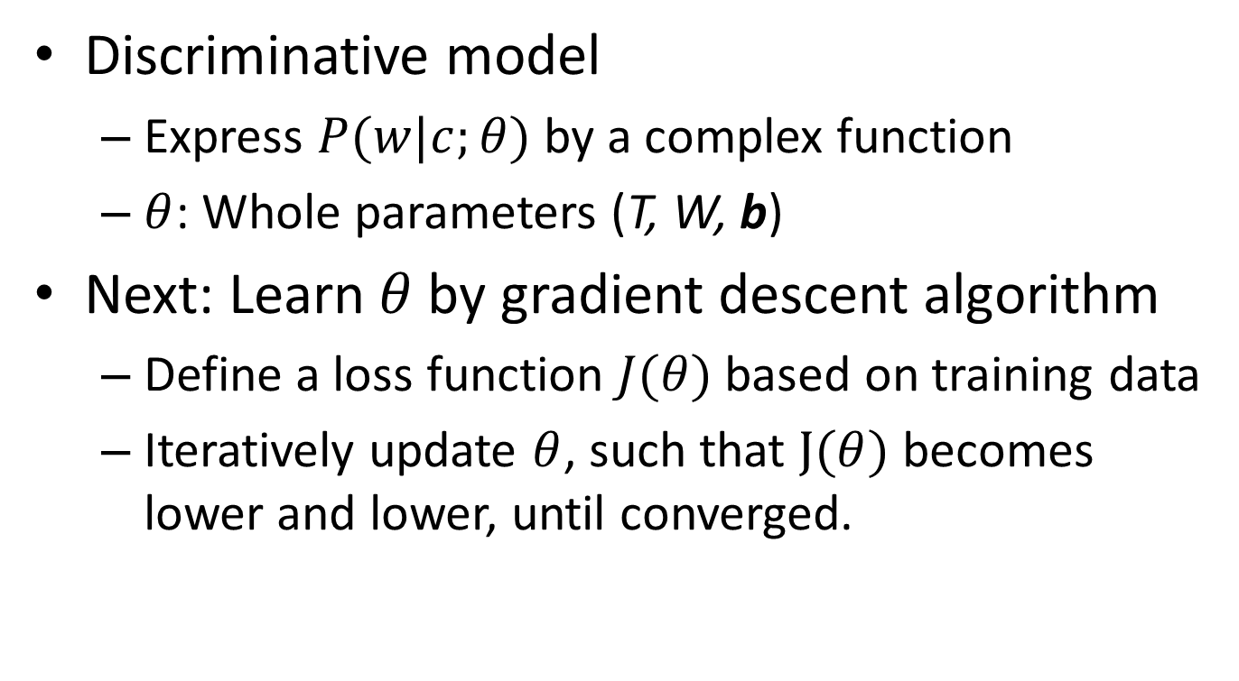
Neural Network Training
Discriminative model
Express $P(w|c;θ)$ by a complex function
$θ$: Whole parameters (T, W, b)
Next: Learn $θ$ by gradient descent algorithm
Define a loss function $J(θ)$ based on training data
Iteratively update $θ$, such that $J(θ)$ becomes lower and lower, until converged.
Notes:
In the next step, we are going to estimate parameters theta by learning algorithms, for example gradient descent.
Hope that all of you guys are familiar with GD.
gradient function will be used.

Slide 8
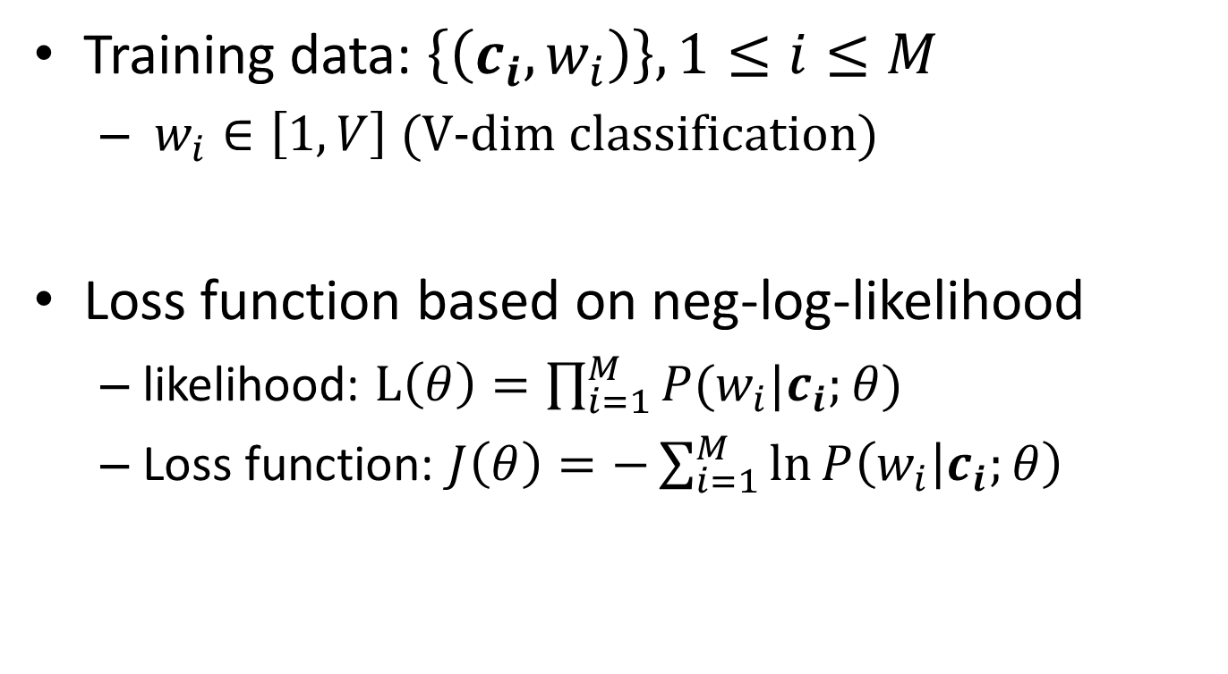
Loss Function in Word Embedding
Training data: $\left\{\left(c_{i},w_{i}\right)\right\}, 1≤i≤M$
$w_{i}∈\left[1, V\right]$ (V-dim classification)
Loss function based on neg-log-likelihood
likelihood: $L\left(θ\right)=\prod_{i=1}^{M}{P(w_{i}|c_{i};θ)}$
Loss function: $J\left(θ\right)=−\sum_{i=1}^{M}{\ln{P\left(w_{i} | c_{i};θ\right)}}$
Notes:
training data: <contexts, word> extracted from large amount of sentences.
The best parameter would maximize the likelihood function, which is the multiplication of conditional prob. for each training data.
So we could define the loss func. as neg-log-likelihood.

Slide 9

Quiz 1
With M training data given, only considering the step from projection layer (x) to output layer (w), what’s the time complexity of calculating the loss function?
A. M*D*V
B. (M+V)*D
C. (M+D)*V
D. M*V
[Correct]
V-dim
output layer
$$y=Softmax(Wx+b)$$
projection layer
D-dim
Notes:
Board: p(w|c)
Draw a softmax layer graph
Complexity: M*H*V
M*H (V+M)*H (H+M)*V
Write on board: $J\left(θ\right)=−\sum_{i=1}^{M}{\ln{P\left(w_{i} | c_{i};θ\right)}}$
write P() on board.

Slide 10
Time Complexity Problem
O(M*D*V) is intractable
V ~= 1,000,000
D >= 100
M >= 100,000,000
How to reduce complexity?
M isn’t reducible: must scan each training data
D is hard to reduce: accuracy drops
Working on V!
Notes:
D: the accuracy of the model will drop dramatically if you want to decrease D by at least one magnitude.

Slide 11
Content
Word Embedding as Example
Typical learning model
Problem in time complexity
Hierarchical Softmax
Noise-Contrastive Estimation
Evaluation on Word Embedding Task
Conclusion

Slide 12
Hierarchical Softmax
w₂
w₃
Intuition: Convert a V-dim classification task into several binary classification tasks.
w₁
w₄
w₅
output layer (hierarchy)
w₆
projection layer
Notes:
The output layer is changed into a binary tree, where each leaf node represents a word.
Similar with softmax regression, we calculate the posterior prob. of each word given x from projection layer,
instead of performing a time-consuming normalization step, HSoft separates the original V-dim classification task
into several binary classification tasks.
I’ll show you how the technique works in the next few slides.

Slide 13
Huffman Tree
olympic
1
3
games
Leaf Node: Word occurrence
in the corpus
Non-leaf: the sum occurrences of its children
Property: A more popular word has a shorter distance to the root node.
brazil
like
watching
5
4
6
8
9
14
I
I: 1
like: 010
watching: 011
brazil: 000
olympic: 0010
games: 0011
23
15
38
Notes:
We use frequency of each word in the corpus to build a Huffman Tree. (Procedure is shown on board)
Encoding each word as a 0/1 sequence determined by the path from root

Slide 14
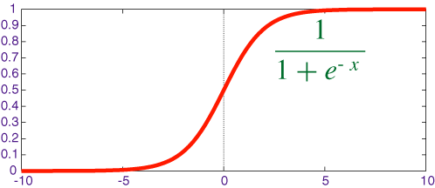
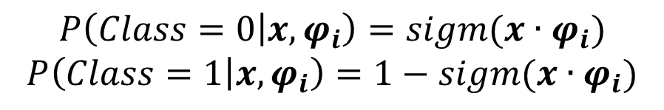





Classification Step
olympic
1
3
games
Predicting the output word:
conducting several binary
classifications along the path
brazil
like
watching
5
4
6
8
$$φ_{5}$$
9
14
$$φ_{3}$$
$$φ_{4}$$
I
23
15
$$φ_{2}$$
38
$$φ_{1}$$
$$P\left(Class=0 | x,φ_{i}\right)=sigm(x∙φ_{i})$$
$$P\left(Class=1 | x,φ_{i}\right)=1−sigm(x∙φ_{i})$$
Notes:
Now let’s see how to compute the posterior probability on the tree
Each non-leaf node corresponds to a binary classifier parameterized by \phi_i
the output of each binary classifier is the probability that the correct word is in the left / right sub tree of the current node.
Quiz: olympic

Slide 15
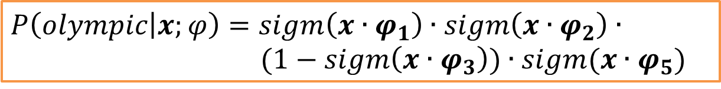





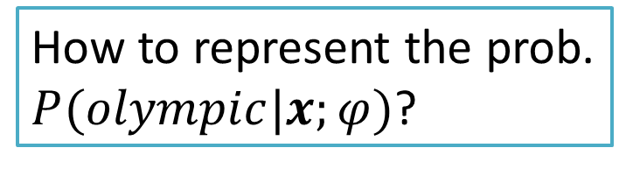
Quiz 2
olympic
1
3
games
How to represent the prob.
$P(olympic|x;φ)$?
brazil
like
watching
5
4
6
8
$$φ_{5}$$
9
14
$$φ_{3}$$
$$φ_{4}$$
I
23
15
$$φ_{2}$$
38
$$φ_{1}$$
$$P\left(olympic | x;φ\right)=sigm\left(x∙φ_{1}\right)∙sigm\left(x∙φ_{2}\right)∙$$
$(1−sigm\left(x∙φ_{3}\right))∙sigm(x∙φ_{5})$
Notes:
Now let’s see how to compute the posterior probability on the tree
Quiz: olympic

Slide 16
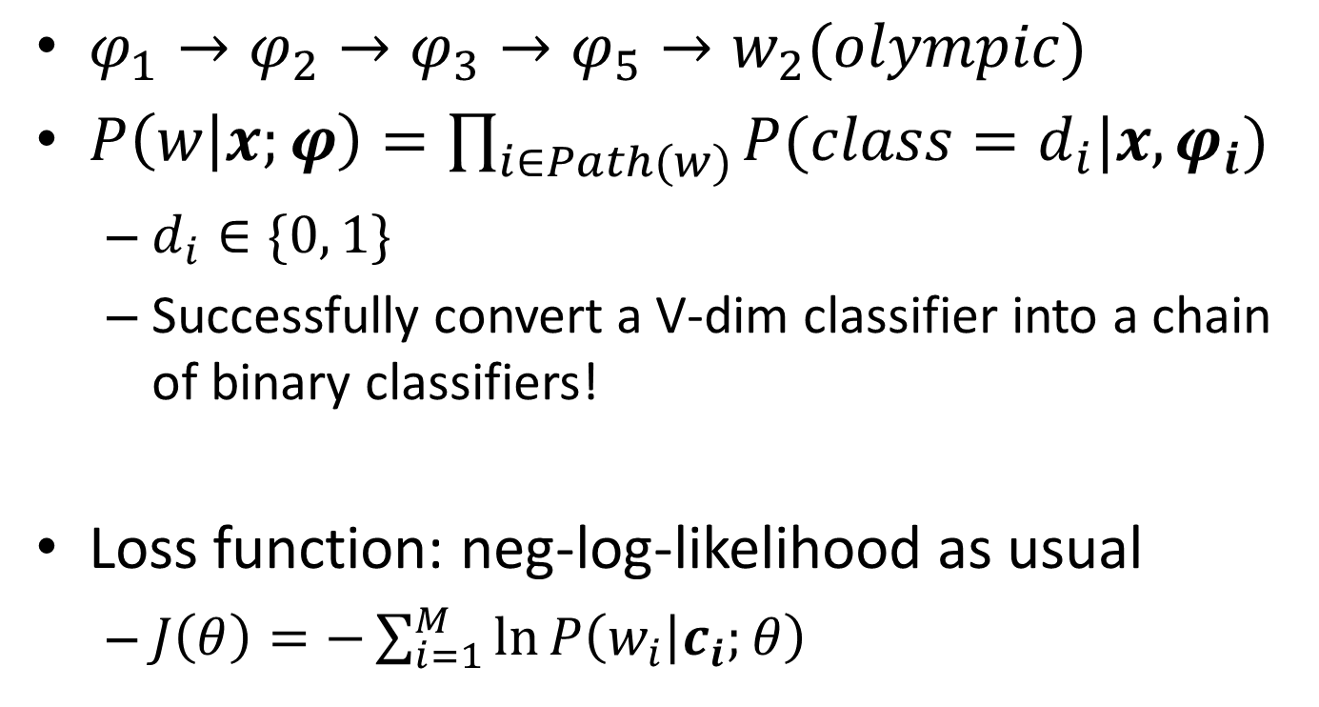
Loss Function
$φ_{1}→φ_{2}→φ_{3}→φ_{5}→w_{2}(olympic)$
$P\left(w | x;φ\right)=\prod_{i∈Path(w)}{P(class=d_{i}|x,φ_{i})}$
$d_{i}∈\{0, 1\}$
Successfully convert a V-dim classifier into a chain of binary classifiers!
Loss function: neg-log-likelihood as usual
$J\left(θ\right)=−\sum_{i=1}^{M}{\ln{P\left(w_{i} | c_{i};θ\right)}}$
Notes:
x = f_T(c)

Slide 17
Hierarchical Softmax: Summary
Advantage: Time complexity is reduced to sublinear
O(M*D*logV)
20 times faster when vocabulary size >= 1,000,000
Disadvantage: Finding a well-performing tree is not a trivial task
Huffman: Only guarantee that a more popular word will map to a shorter classifying chain.
Two similar words could be separated at the root of the tree.
Notes:
example: cat and dog separated at the beginning, which doesn’t make sense.
A more reasonable hierarchy should classify at a coarse grained level first,

Slide 18
Content
Word Embedding as Example
Typical learning model
Problem in time complexity
Hierarchical Softmax
Noise-Contrastive Estimation
Evaluation on Word Embedding Task
Conclusion

Slide 19
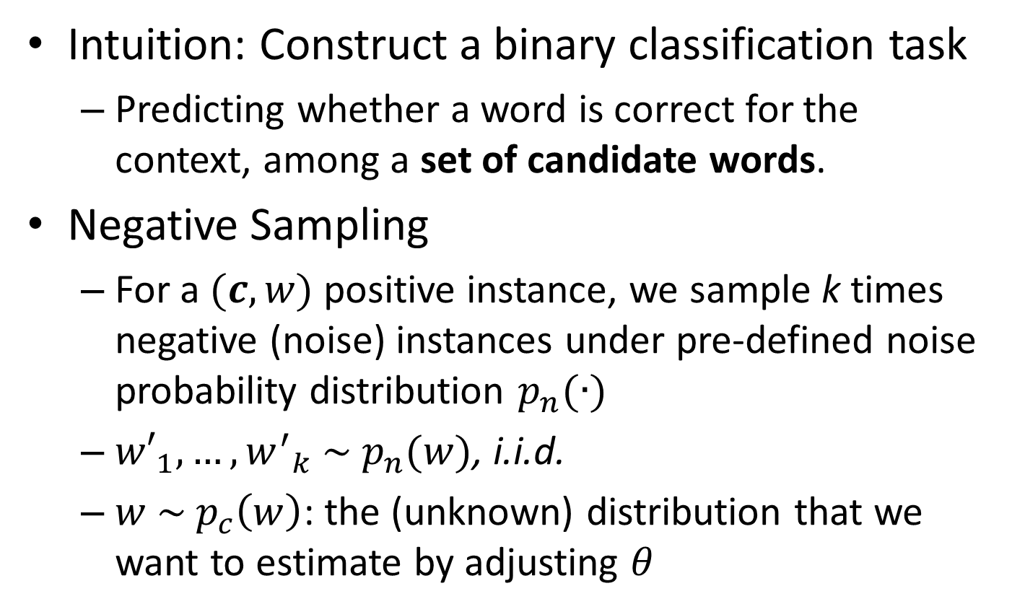
Noise-Contrastive Estimation
Intuition: Construct a binary classification task
Predicting whether a word is correct for the context, among a set of candidate words.
Negative Sampling
For a $(c,w)$ positive instance, we sample k times negative (noise) instances under pre-defined noise probability distribution $p_{n}(∙)$
${w′}_{1},…,{w^{′}}_{k} \sim p_{n}(w)$, i.i.d.
$w \sim p_{c}\left(w\right)$: the (unknown) distribution that we want to estimate by adjusting $θ$
Notes:
In this section, we fix the context c, and only focus on one single training data.

Slide 20
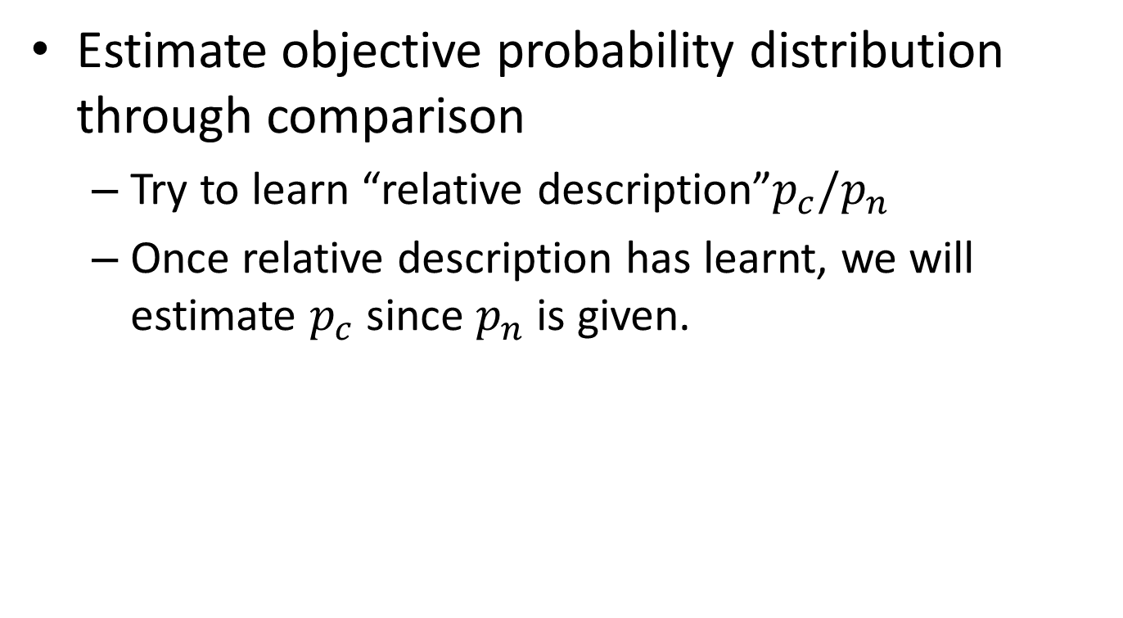
Why Negative Sampling?
Estimate objective probability distribution through comparison
Try to learn “relative description”$p_{c}{/p}_{n}$
Once relative description has learnt, we will estimate $p_{c}$ since $p_{n}$ is given.
Notes:
Once we have generated a batch of negative data, we could ……
“relative description”噪声对比估计

Slide 21
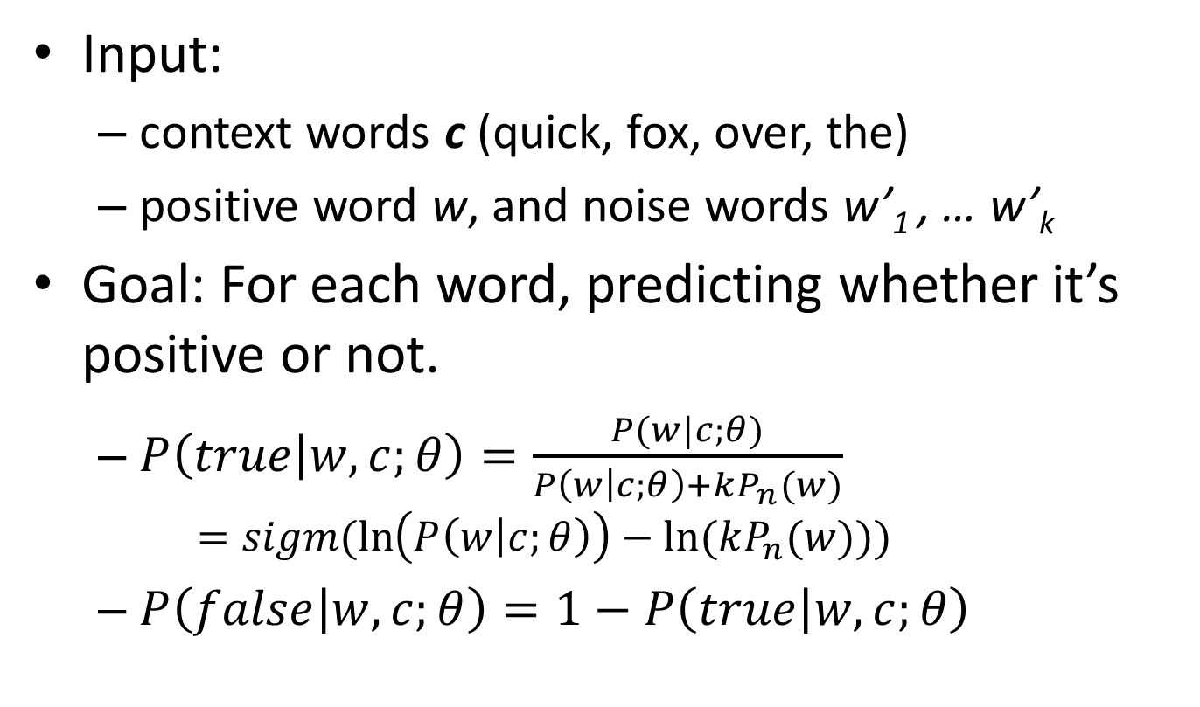
Construct a Binary Classification Task
Input:
context words c (quick, fox, over, the)
positive word w, and noise words w’₁ , … w’_{k}
Goal: For each word, predicting whether it’s positive or not.
$P\left(true | w,c;θ\right)=\frac{P(w|c;θ)}{P\left(w | c;θ\right)+kP_{n}(w)}$
$$=sigm(\ln\left(P\left(w | c;θ\right)\right)−ln⁡(kP_{n}(w)))$$
$P\left(false | w,c;θ\right)=1−P\left(true | w,c;θ\right)$
Notes:
Now I show you how to learn the parameters under the NCE setting.
k: we know that noise are k times larger than positive words.

Slide 22
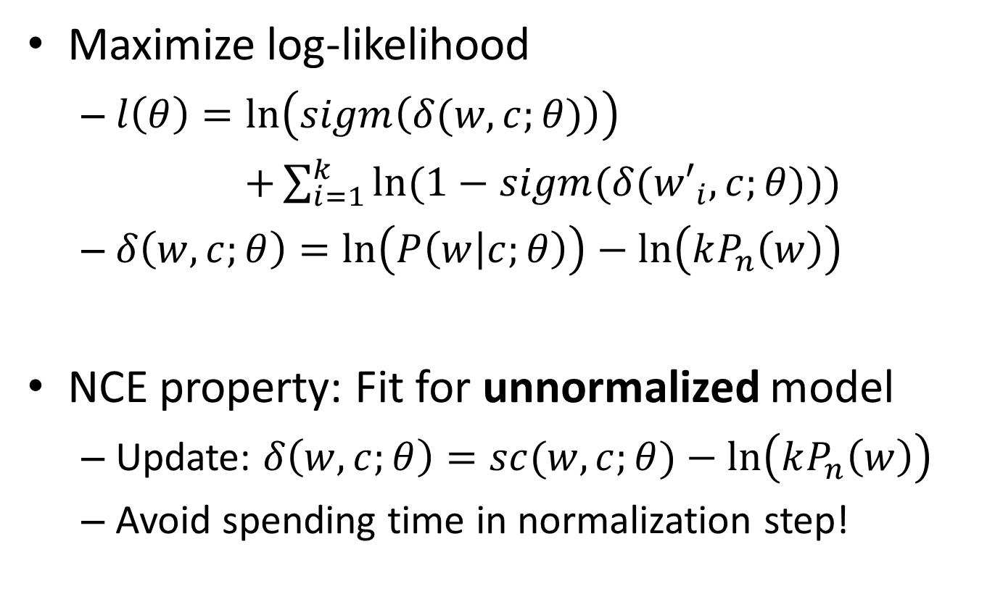
Loss Function in NCE
Maximize log-likelihood
$l\left(θ\right)=\ln\left(sigm\left(δ(w,c;θ)\right)\right)$
$+\sum_{i=1}^{k}{ln⁡(1−sigm(δ({w′}_{i},c;θ)))}$
$δ\left(w,c;θ\right)=\ln\left(P\left(w | c;θ\right)\right)−\ln\left(kP_{n}\left(w\right)\right)$
NCE property: Fit for unnormalized model
Update: $δ\left(w,c;θ\right)=sc(w,c;θ)−\ln\left(kP_{n}\left(w\right)\right)$
Avoid spending time in normalization step!
Notes:
relative description
The same shape: P and exp(sc)
We can do this because the NCE objective encourages the model to be approximately normalized and recovers a perfectly normalized model if the model class contains the data distribution

Slide 23
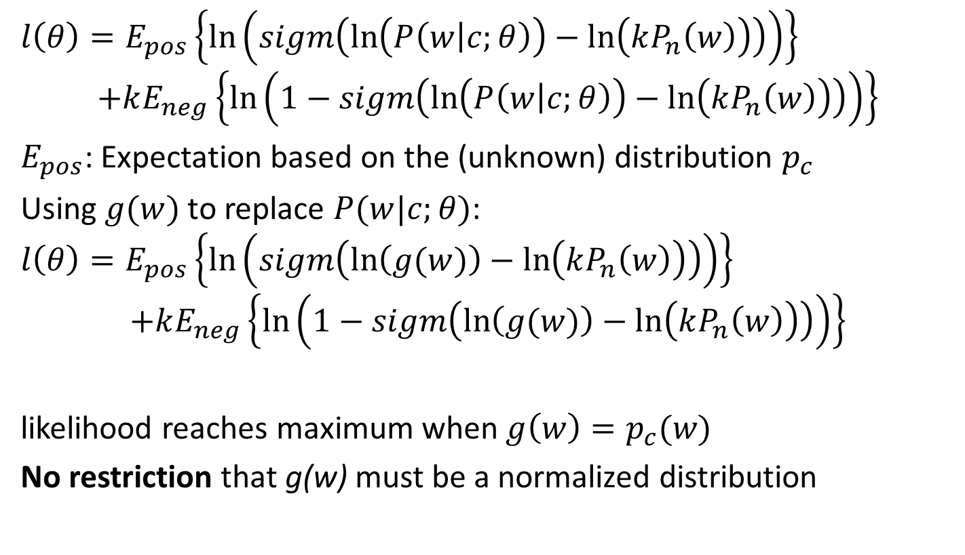
Prove (not important)
$$l\left(θ\right)=E_{pos}\left\{\ln\left(sigm\left(\ln\left(P\left(w | c;θ\right)\right)−\ln\left(kP_{n}\left(w\right)\right)\right)\right)\right\}$$
$$+kE_{neg}\left\{\ln\left(1−sigm\left(\ln\left(P\left(w | c;θ\right)\right)−\ln\left(kP_{n}\left(w\right)\right)\right)\right)\right\}$$
$E_{pos}$: Expectation based on the (unknown) distribution $p_{c}$
Using $g(w)$ to replace $P(w|c;θ)$:
$$l\left(θ\right)=E_{pos}\left\{\ln\left(sigm\left(\ln\left(g(w)\right)−\ln\left(kP_{n}\left(w\right)\right)\right)\right)\right\}$$
$$+kE_{neg}\left\{\ln\left(1−sigm\left(\ln\left(g(w)\right)−\ln\left(kP_{n}\left(w\right)\right)\right)\right)\right\}$$
likelihood reaches maximum when $g\left(w\right)=p_{c}(w)$
No restriction that g(w) must be a normalized distribution
Notes:
Handling unnormalized model
Give a formula (not important)
so we could use an unnormalized distribution in the model and estimate the estimate the shape
If you are interested, you can check the first paper of NCE.

Slide 24
Content
Word Embedding as Example
Typical learning model
Problem in time complexity
Hierarchical Softmax
Noise-Contrastive Estimation
Evaluation on Word Embedding Task
Conclusion

Slide 25
Evaluations on Word Embedding
Learning word embeddings efficiently with noise-contrastive estimation
Andriy Mnih and Koray Kavukcuoglu
DeepMind Technologies
NIPS 2013
Main contribution: Implemented an NCE-based model, and compared with other baselines.

Slide 26
Baselines in Experiments
vLBL: vector Log-BiLinear model
exactly the model shown before
CBOW: Continuous Bag-Of-Word model
vLBL + Hierarchical Softmax
ivLBL: inversed version of vLBL
Given the word (“jumped”), predicting its context words (“quick” “fox” “over” “the”)
Skip-Gram model
ivLBL + Hierarchical Softmax
Notes:
Flash!

Slide 27
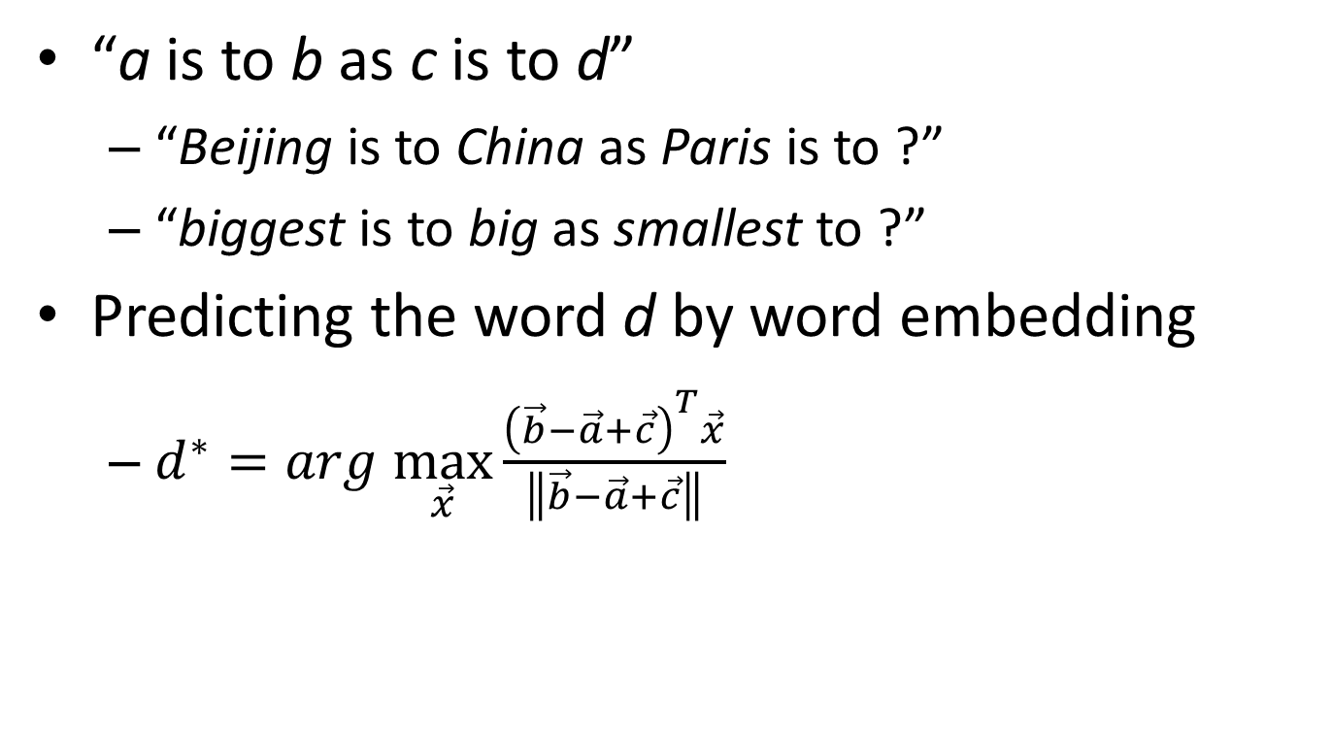
Evaluating Task
“a is to b as c is to d”
“Beijing is to China as Paris is to ?”
“biggest is to big as smallest to ?”
Predicting the word d by word embedding
$d^{∗}=arg \max_{\vec{x}}{\frac{{\left(\vec{b}−\vec{a}+\vec{c}\right)}^{T}\vec{x}}{\left\|\vec{b}−\vec{a}+\vec{c}\right\|}}$
Notes:
semantic / syntactic

Slide 28
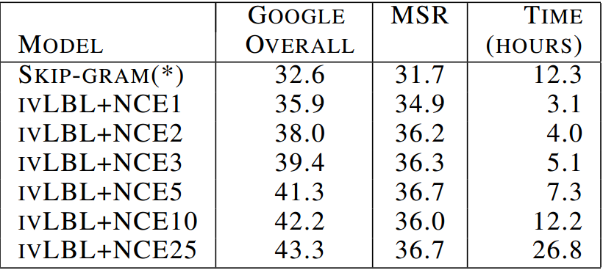
Evaluation Results
Embedding dimension = 100, Window size = 5
Trained on Wikipedia Dump (April 2013, ~1.5B words)
Notes:
window=5, dim=100

Slide 29
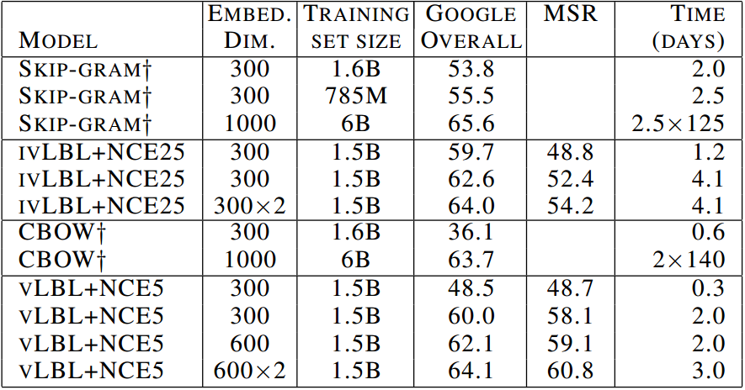
Evaluation Results
Embedding dimension is varied, training time is varied.
Trained on Wikipedia Dump (April 2013, ~1.5B words)

Slide 30
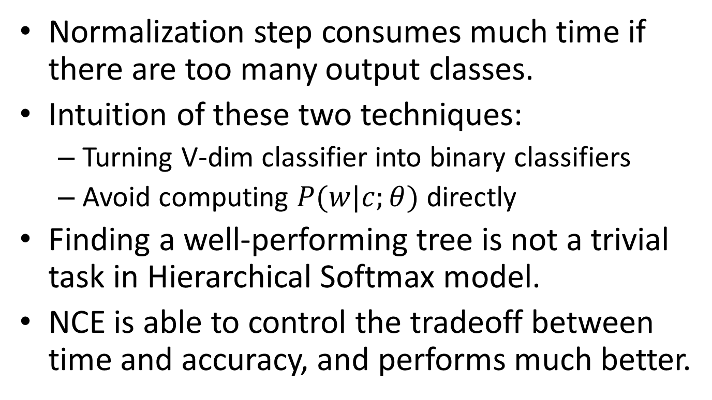
Conclusion
Normalization step consumes much time if there are too many output classes.
Intuition of these two techniques:
Turning V-dim classifier into binary classifiers
Avoid computing $P(w|c;θ)$ directly
Finding a well-performing tree is not a trivial task in Hierarchical Softmax model.
NCE is able to control the tradeoff between time and accuracy, and performs much better.

Slide 31
THANKS for listening!!

